Slide 1
FocusQuest
Sanskriti Aripineni, Javier Benzo San Martin, Ndubueze Echefu, Raphael Evangelista, Leslie Flores, Juan Laseter, Steven Martinez Sanchez, Disha Shetty, Hunter Smith

Slide 2
Focus Quest Goals
Context of Product
To help stay focused in this fast-paced world.
Traditional productivity methods are hard to follow, and it is very difficult to build lasting habits. FocusQuest shall tackle this by combining gamification, AI-driven insights, and multi-activity tracking to make productivity attractive and personalized to everyone's needs.
Product Function
Gamify productivity through streaks and points.
Assign levels based on task difficulty level.
Use of AI chatbot to streamline tasks and provide personalized tips and suggestions based on user data and history.

Slide 3
Software Process Model
Waterfall model: We have opted to implement the Waterfall model for this project due to the well-defined requirements and the strict timeline associated with it. Given that this is a class project with limited time, we believe the Waterfall approach will provide the necessary structure and discipline, ensuring that each phase is completed before moving on to the next. Additionally, as our objective is to deliver a final presentation at the conclusion of the project, the sequential nature of the Waterfall model aligns well with our goals, minimizing flexibility towards changes and providing a clear, organized framework for successful project completion.

Slide 4
Functional Requirements
Login
Shall allow customers to login to an account to ensure their data is safe, and previous tasks and streaks are continued.
Inputs: Users shall login with username and password
Processing: Shall validate based on existing database if existing user or shall add user information to database.
Manage Focus Sessions
Shall allow users to track sessions
Shall measure and analyze focus duration
Create tasks
Shall allow users to add tasks they want to complete.
Should allow users to add date/time by when they want to complete it by
Shall allow users to enter expected time for task
Earn Points
Points shall be assigned on task completion
1 Point/minute according to the expected time on task will be assigned, to measure difficulty.
Manage Tasks
Shall allow users to modify information on added tasks, such as expected time, due date/time
Shall allow user to remove/replace task
AI feedback
Shall provide encouragement to complete tasks.
Should provide personalized tips and strategies based on user data
Should provide personalized peak productivity time frames for different types of tasks according to past user data

Slide 5
Non-Functional Requirements
Availability
Occasional maintenance breaks expected but shall be no longer than 1 hr.
Shall not be available offline
Security
User data is secure, and databases shall not be accessible unless legally required.
Usability
The interface shall be easy to use and anyone with basic technology experience should be able to use it with ease.
Performance
Shall not take more than 10 seconds to login.
Task tracking and AI feedback should not take more than 90 seconds.

Slide 6
Diagrams
← Go to Key Functionalities
Go to Testing →
Use-Case Diagram
Sequence Diagram
User
Class Diagram
Session
AI Feedback
Task
PointSystem
Level
Architectural Design

Slide 7

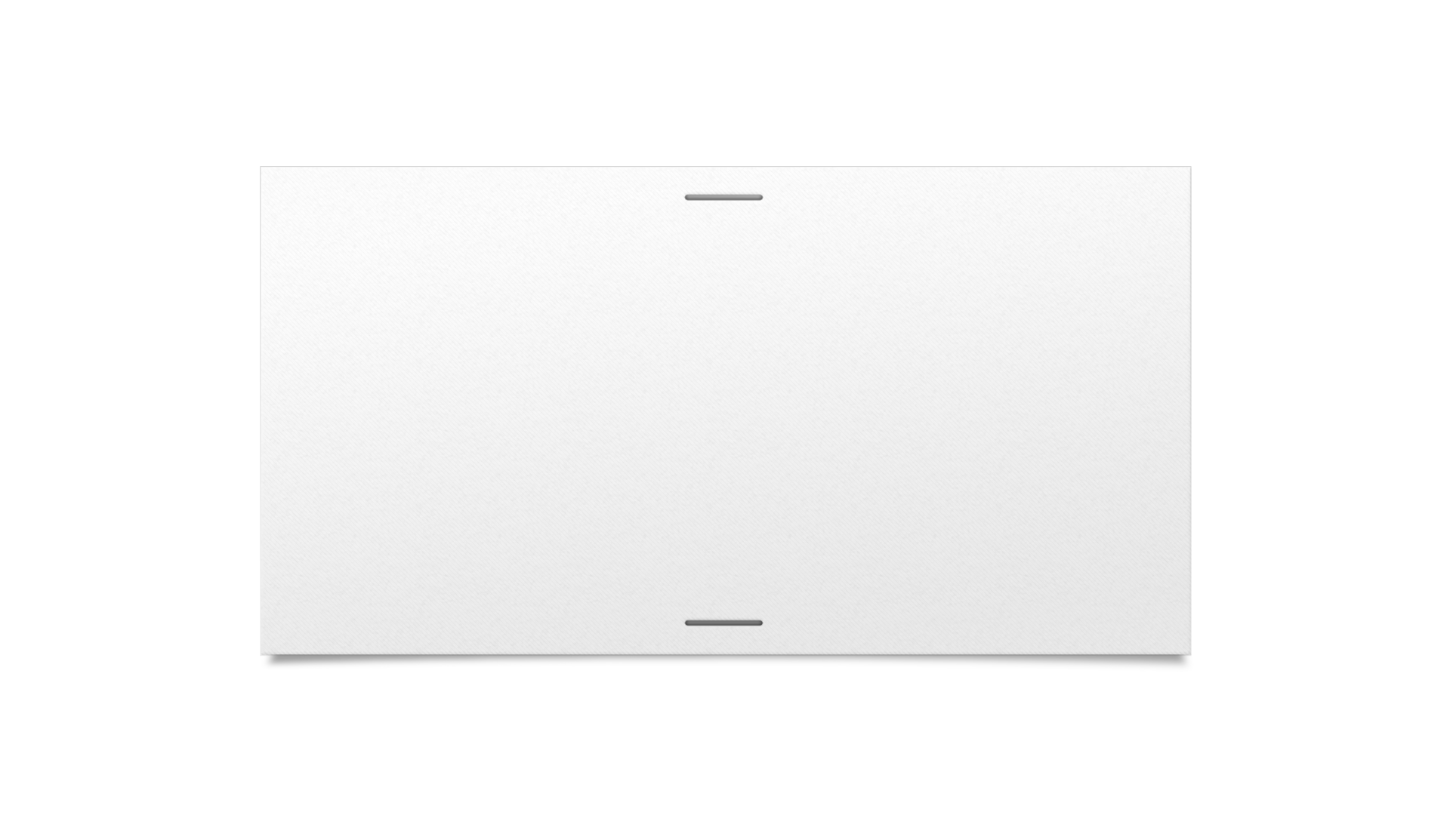



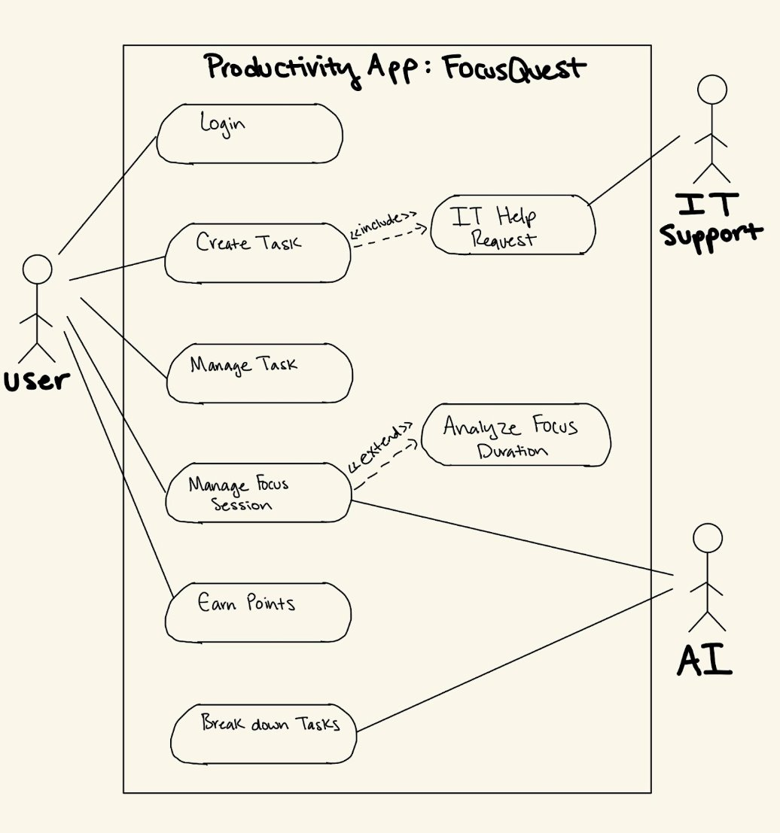
Use-Case Diagram
Back to Diagrams

Slide 8
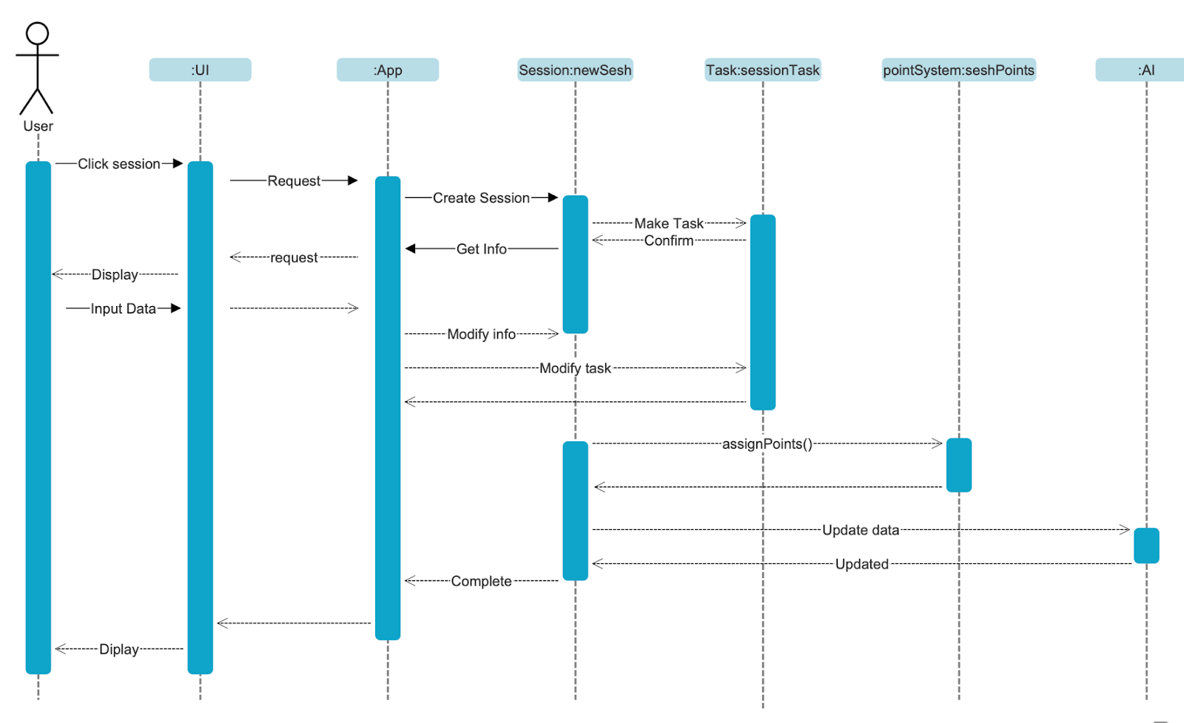
Sequence Diagram
Back to Diagrams

Slide 9
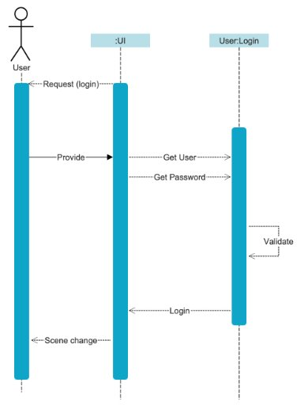
Login
Back to Diagrams
Availability

Slide 10

Manage Focus
Back to Diagrams
Availability

Slide 11
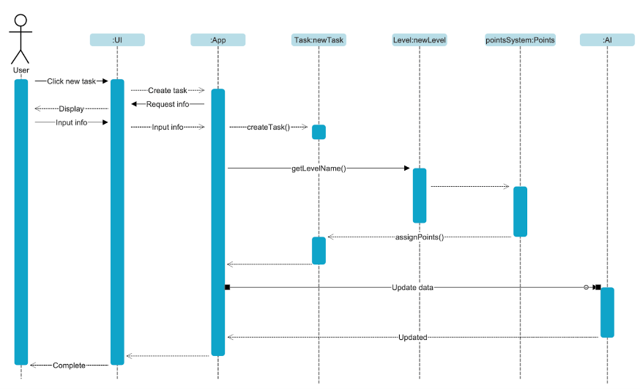
Create Tasks
Back to Diagrams
Availability

Slide 12
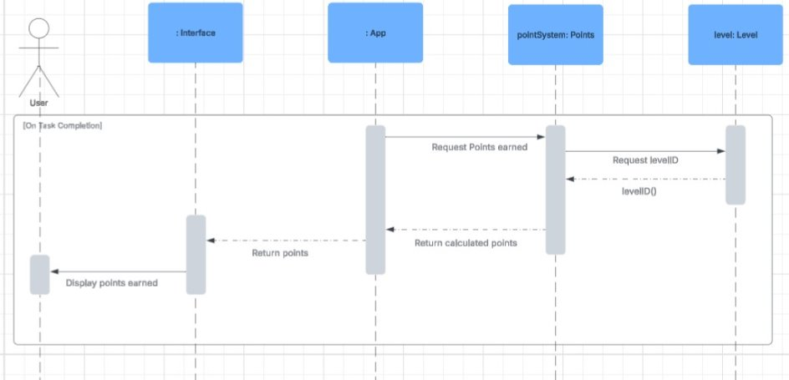
Earn Points
Back to Diagrams
Availability

Slide 13
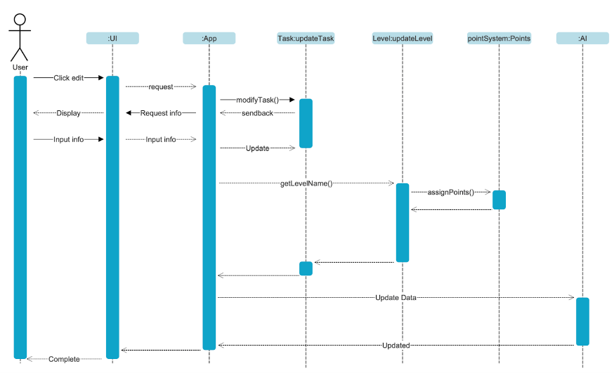
Manage Tasks
Back to Diagrams
Availability

Slide 14
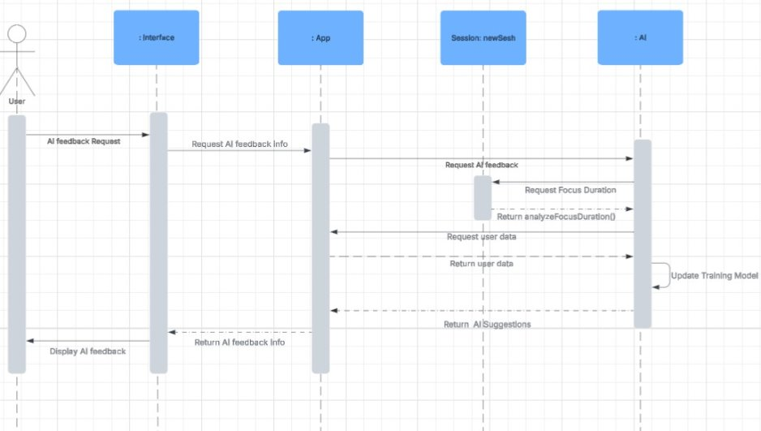
AI Feedback
Back to Diagrams
Availability

Slide 15
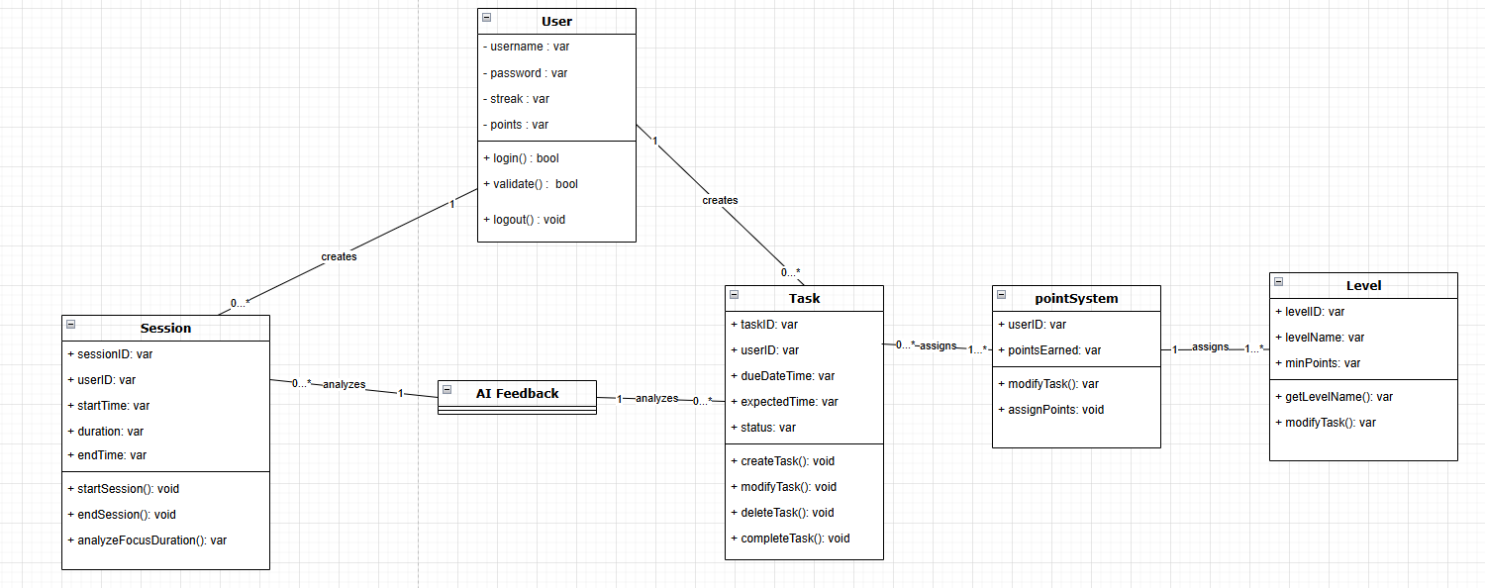
Class diagram
Back to Diagrams

Slide 16
User
Back to Diagrams
Attributes
Username
Password
Streak
Points
Operations
Login
Validate
Logout
Associations
Session
1-0…*
Task
1-0…*

Slide 17
Session
Back to Diagrams
Attributes
SessionID
userID
StartTime
Duration
EndTime
Operations
StartSession
EndSession
AnalyzeFocusDuration
Associations
User
0…*-1
AI Feedback
0…*-1

Slide 18
AI Feedback
Back to Diagrams
Attributes
Operations
Associations
Session
1-0…*
Task
1-0…*

Slide 19
Task
Back to Diagrams
Attributes
taskID
userID
dueDateTime
expectedTime
status
Operations
createTask
modifyTask
deleteTadk
completeTask
Associations
User
0…*-1
AI feedback
0…*-1
pointSystem
0…*-1

Slide 20
PointSystem
Back to Diagrams
Attributes
UserID
pointsEarned
Operations
ModifyTask
AssignPoints
Associations
Level
1-1…*
Task
1…*-0…*

Slide 21
Level
Back to Diagrams
Attributes
LevelID
LevelName
MinPoints
Operations
getLevelName
ModifyTask
Associations
PointSystem
1…*-1

Slide 22
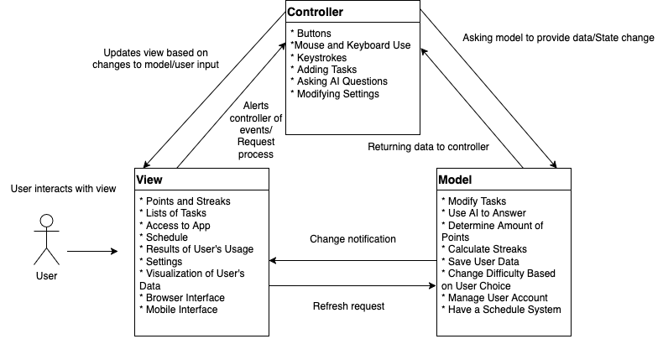
Architectural Design
Back to Diagrams
Notes:
Speaker Notes:
For the architectural design, we chose the Model-View-Controller system due to the nature of the application needing user interaction, servers, and UI display.
From the user's perspective, they can view stuff like
Points and streaks
Lists of tasks
Access to app
Schedule
Results of user's usage
Settings
Visualization of User's Data
The interface, either Browser or mobile.
The user has the power to:
Use mouse and keyboard

Slide 23
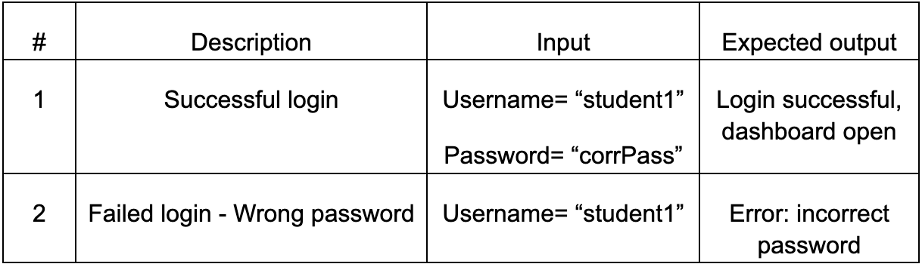
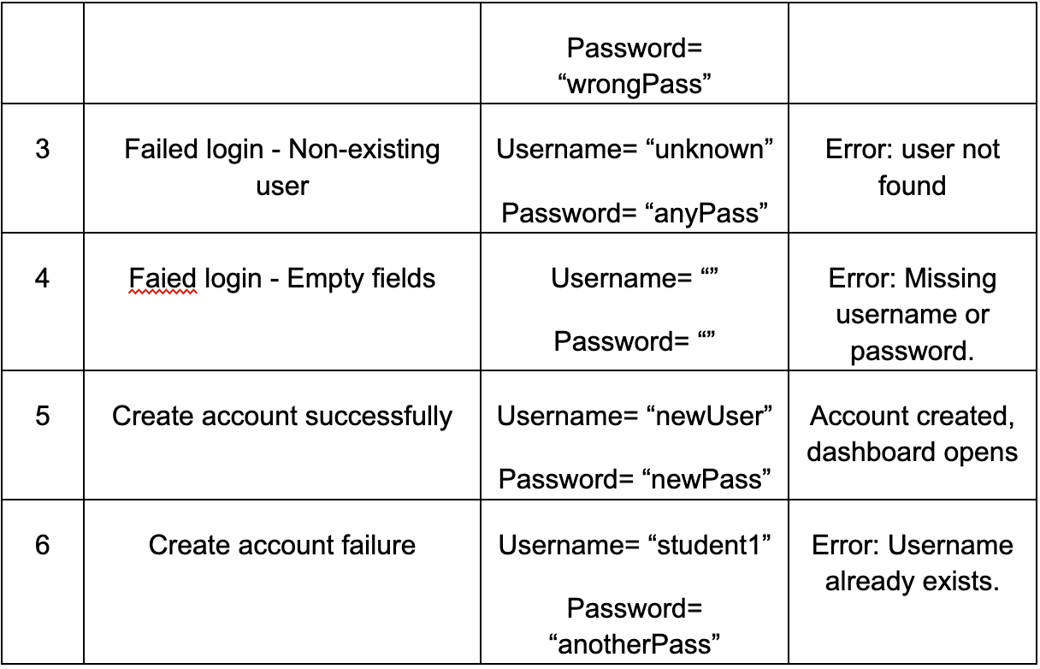
Login

Slide 24
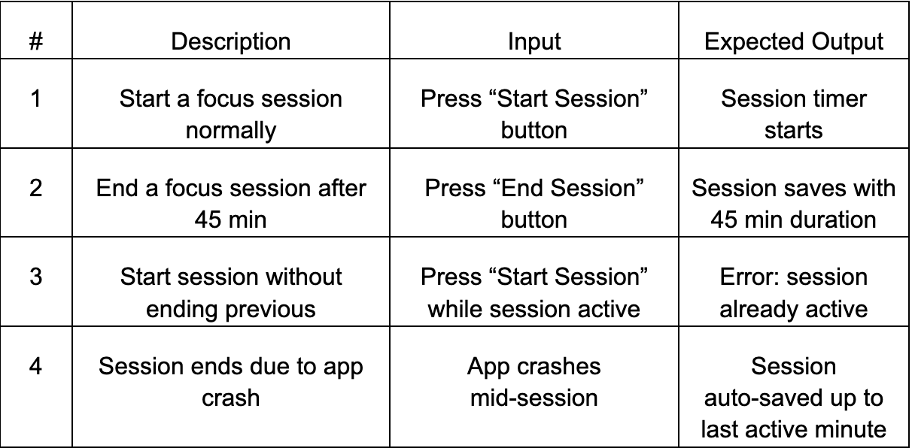
Manage Focus Sessions

Slide 25
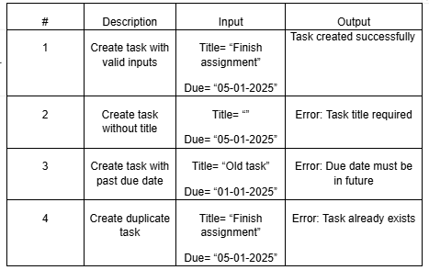
Create Tasks

Slide 26
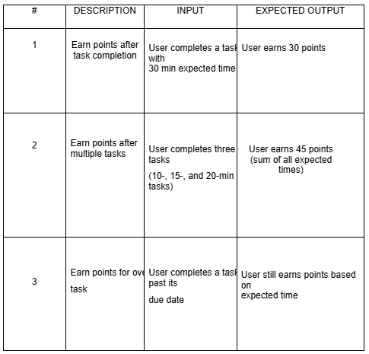
Earn Points

Slide 27
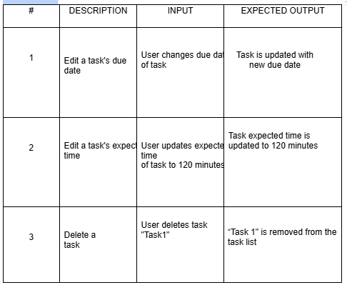
Manage Tasks

Slide 28
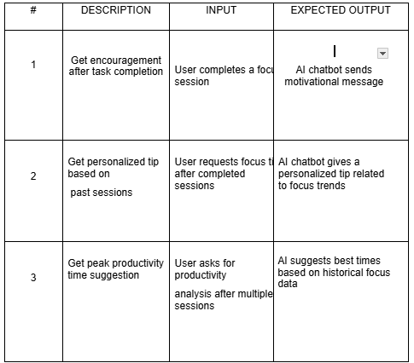
AI Feedback

Slide 29
Project Management/Scheduling
General Scheduling
Gaant Chart
General Gannt Chart
Individual-tasked Gannt Chart
Planning
Financial Costs
Estimated cost of Hardware
Estimated cost of Software
Personnel Costs

Slide 30
General Schedule we went with
← Back to Project Management / Scheduling
Planning and Organization – Up until April 21st:
Task Delegation
Review and Revise Deliverable 1
Project Scheduling and Staffing
Cost, Effort & Pricing Estimation
Development and Testing – Up Until April 25th:
Test Plan
Comparison with Similar Designs
Repository Submission
Finalization and Presentation – Up until April 28th:
Conclusion
Presentation Slides (with prototype demo)
References
BONUS: Demo Implementation

Slide 31
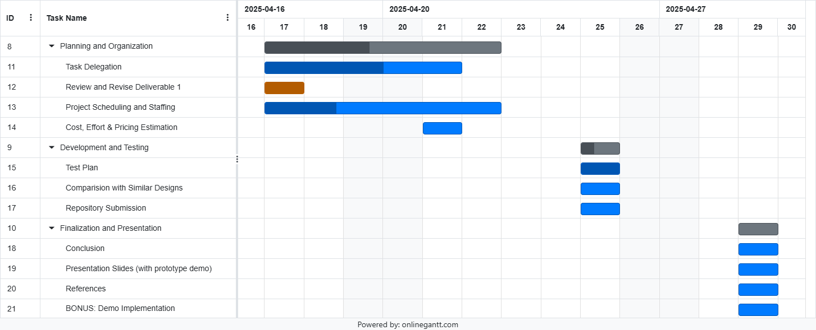
General Gannt Chart
← Back to Project Management / Scheduling

Slide 32
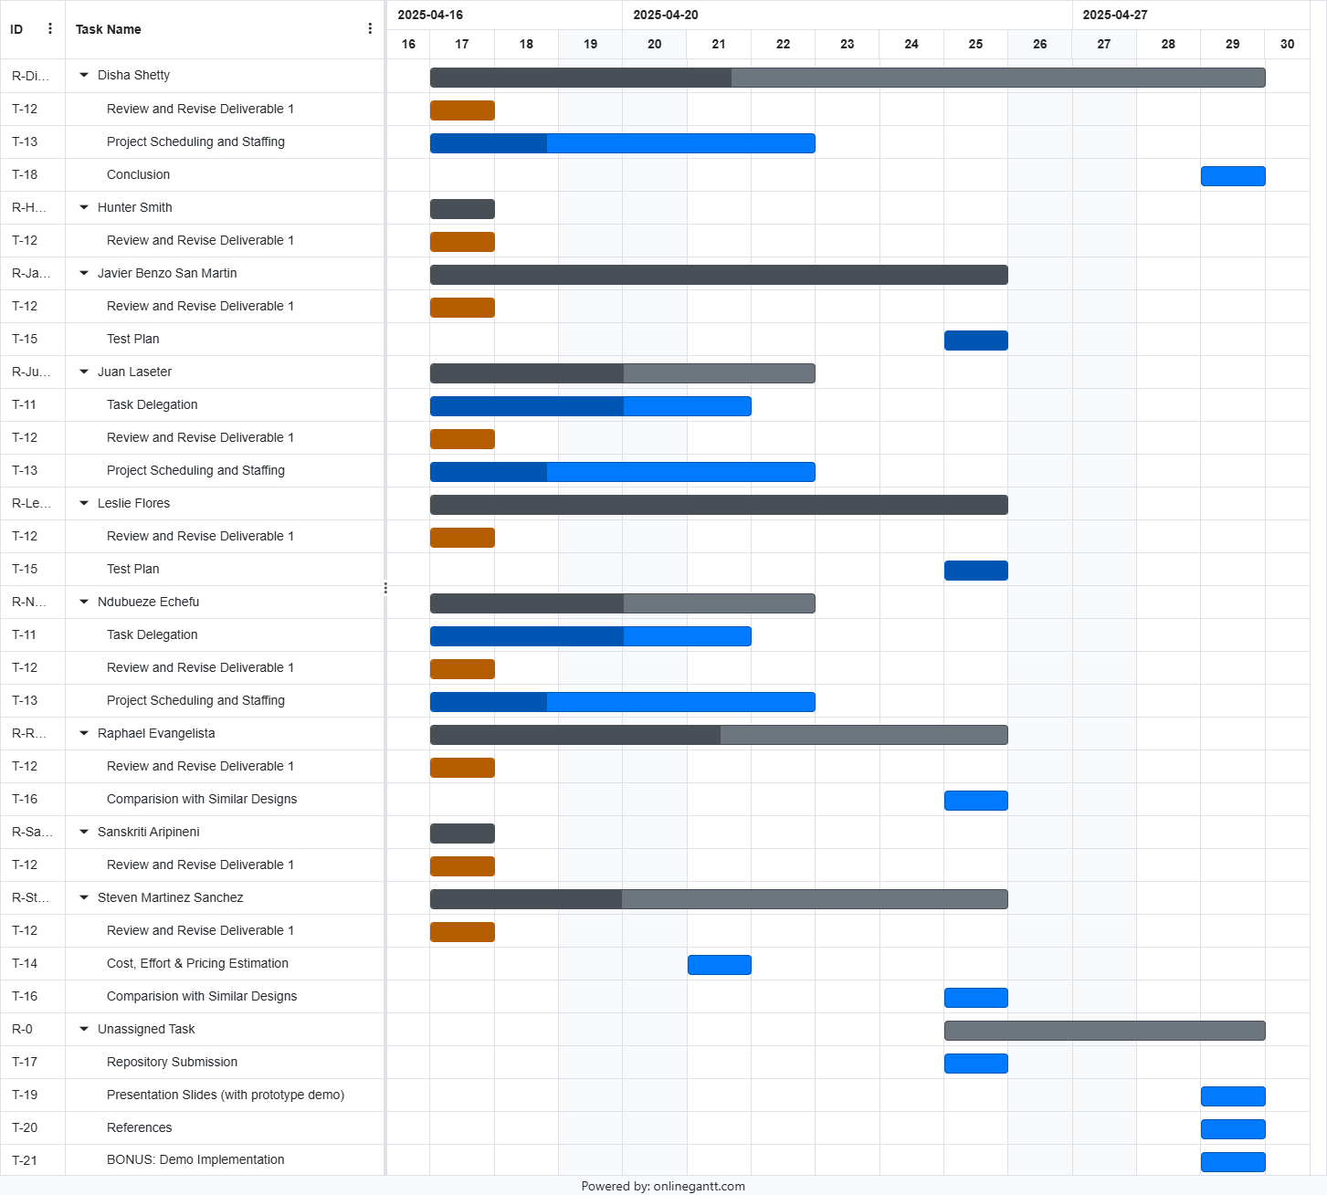
← Back to Project Management / Scheduling
Go to second part →

Slide 33
← Back to Project Management / Scheduling
←Go to first part

Slide 34
Planning
← Back to Project Management / Scheduling
Milestone | Description
M1 | Planning Complete (T1 done)
M2 | Test Plan Ready
M3 | Design Comparison Complete
M4 | Estimation Complete
M5 | Presentation Content Ready
M6 | Review and References Done
M7 | Demo Built
M8 | Final Deliverables Submitted
Task | Task Name | Effort (person-days) | Duration (days) | Dependencies
T1 | Task Delegation | 15 | 10 | —
T2 | Review and Revise Deliverable 1 | 4 | 5 | —
T3 | Project Scheduling and Staffing | 20 | 15 | T1 (M1)
T4 | Test Plan | 5 | 10 | T1 (M1)
T5 | Comparison with Similar Designs | 5 | 10 | T2, T4 (M3)
T6 | Cost, Effort & Pricing Estimation | 10 | 5 | T1, T2 (M4)
T7 | Review and Revise Deliverable 1.1 | 6 | 5 | T1 (M1)
T8 | Repository Submission + References | 5 | 5 | T4 (M2)
T9 | Presentation Slides + Demo | 10 | 15 | T3, T6 (M5)
T10 | Conclusion | 10 | 10 | T7, T8 (M6)
T11 | BONUS: Demo Implementation | 15 | 10 | T9 (M7)
T12 | Final Submission | 10 | 10 | T10, T11 (M8)

Slide 35
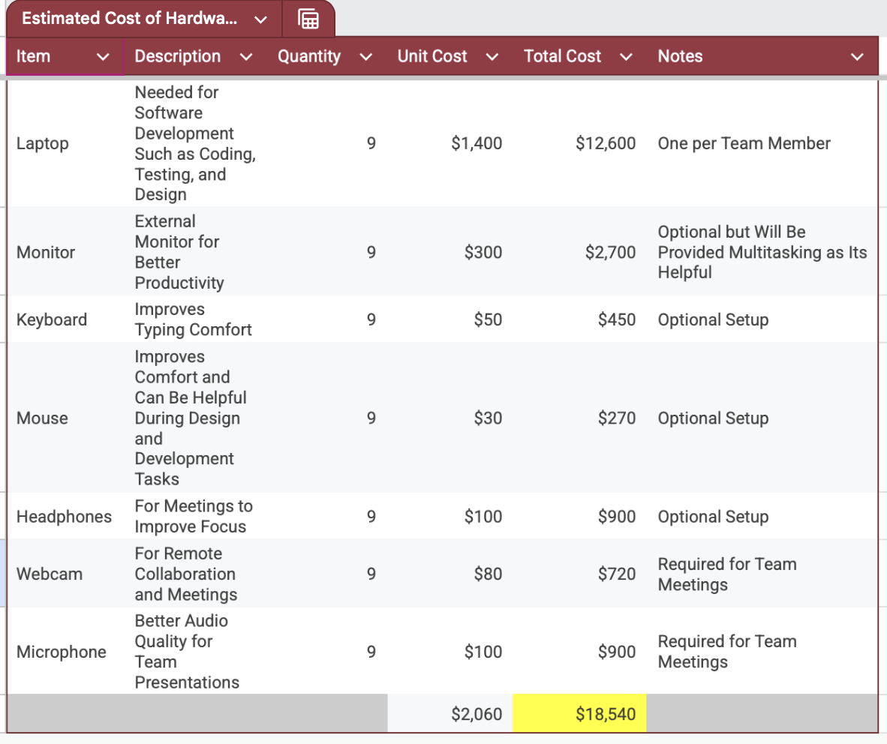
← Back to Project Management / Scheduling

Slide 36
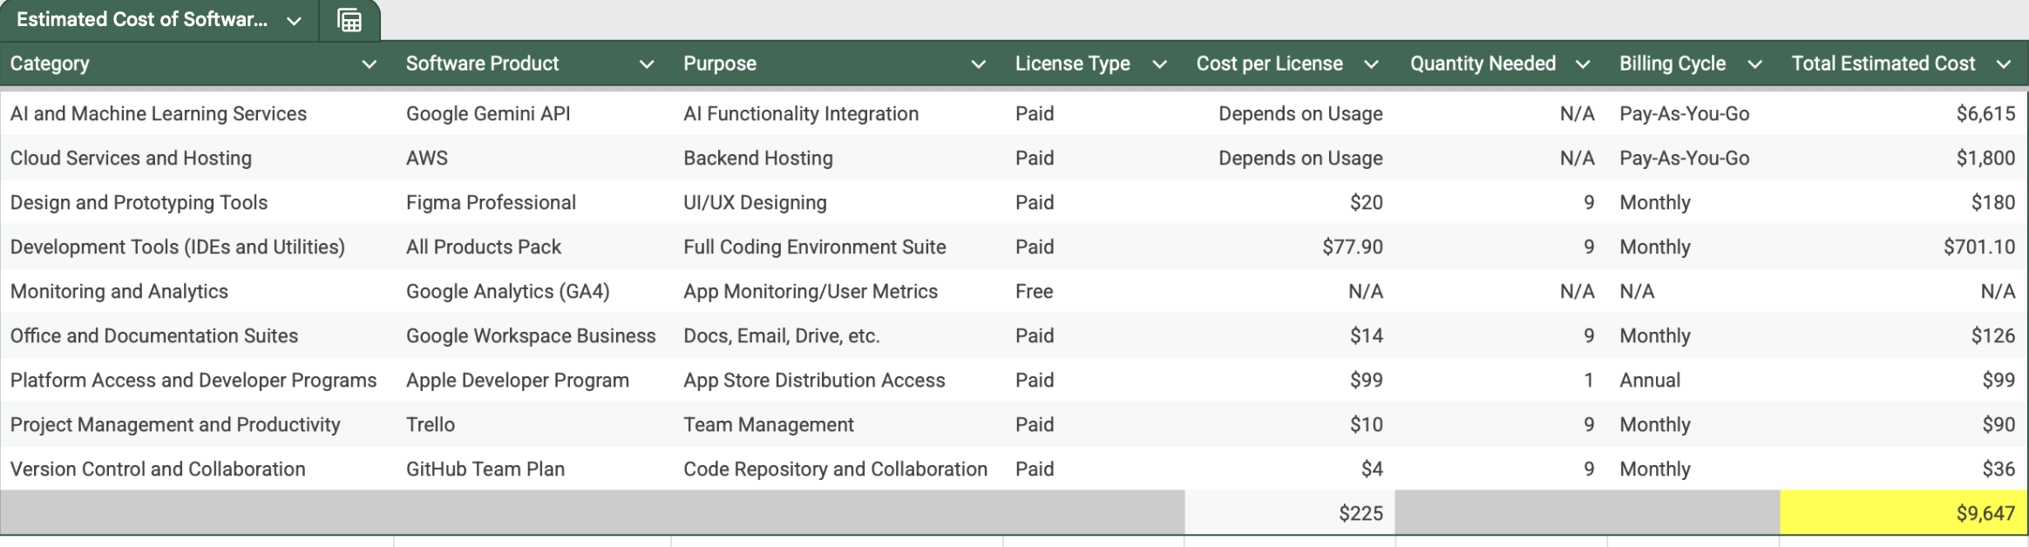
← Back to Project Management / Scheduling

Slide 37
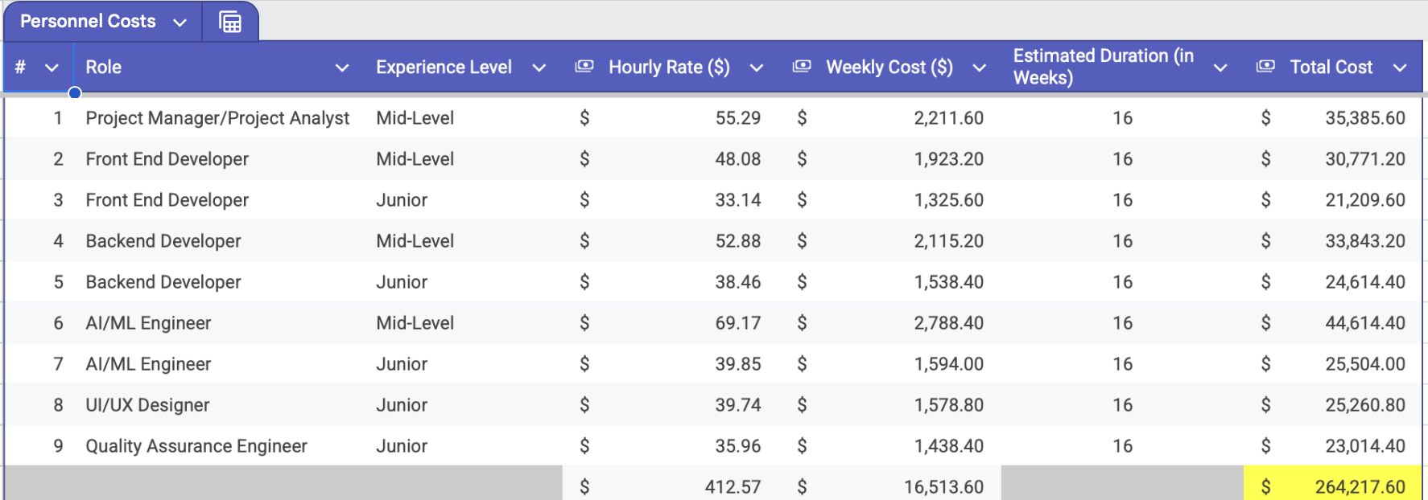
← Back to Project Management / Scheduling

Slide 38
Prototype
Slides included as pdf Link to Figma Prototype

Slide 39
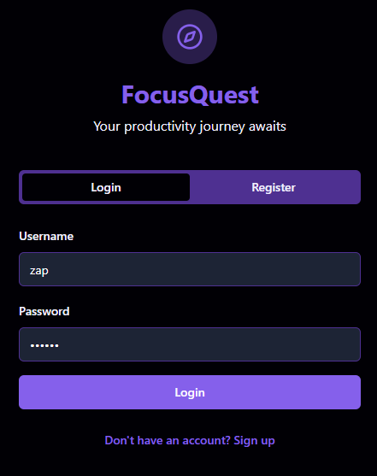

Focus Quest
LOGO HERE

Slide 40


Frontend
Technology
Built with React powered by Vite as the build tool
Uses TailwindCSS for styling
Components:
UI Components: Reusable components located in client/src/components/ui/. For example, the ChartStyle and ChartTooltip components handle rendering charts with dynamic styling based on props.
Pages: Application pages found in client/src/pages/, such as auth-page.tsx where users can log in and manage their profiles.

Slide 41
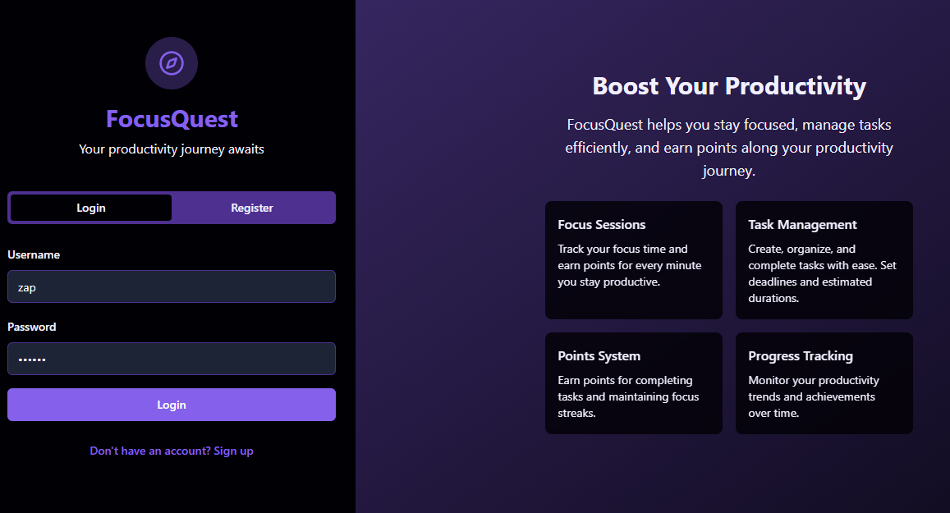
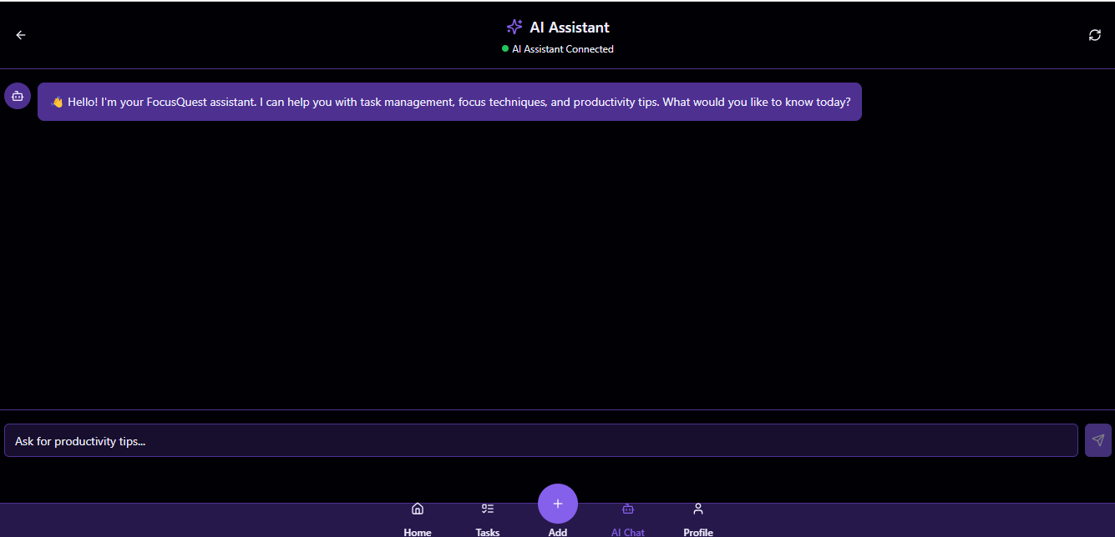
Backend
Technology
Node.js with Express.js handling API requests (Gemini API)
Routing
The primary routes defined in server/routes.ts that include endpoints for AI integration and user session management.
Middleware
The isAuthenticated middleware ensures that sensitive endpoints require user authentication.
Database
Interaction with PostgreSQL configured using Drizzle ORM in server/db.ts.

Slide 42
Function category counts
Category | Details
User Inputs | 🔹 Variable Input : Depends on the UI in ai-page.tsx. 🔹 Dynamic based on the number of input fields and user interactions (e.g., multiple messages).
User Outputs | 🔹 Variable Output : Generated dynamically by AI in response to user inputs. 🔹 Each interaction appends a message (user or AI) on the UI.
User Queries | 🔹 Approx. 4 Queries defined in server/routes.ts: • GET /api/ai/status • POST /api/ai/message • Others for user data and focus sessions
Relational Tables | 🔹 3 Tables: • users • tasks • focus_sessions
External Interfaces | 🔹 1 Interface : Integration with AI services (e.g., OpenAI/Gemini). 🔹 Used for API key checks and message exchange.

Slide 43
Comparing Similar Designs

Slide 44

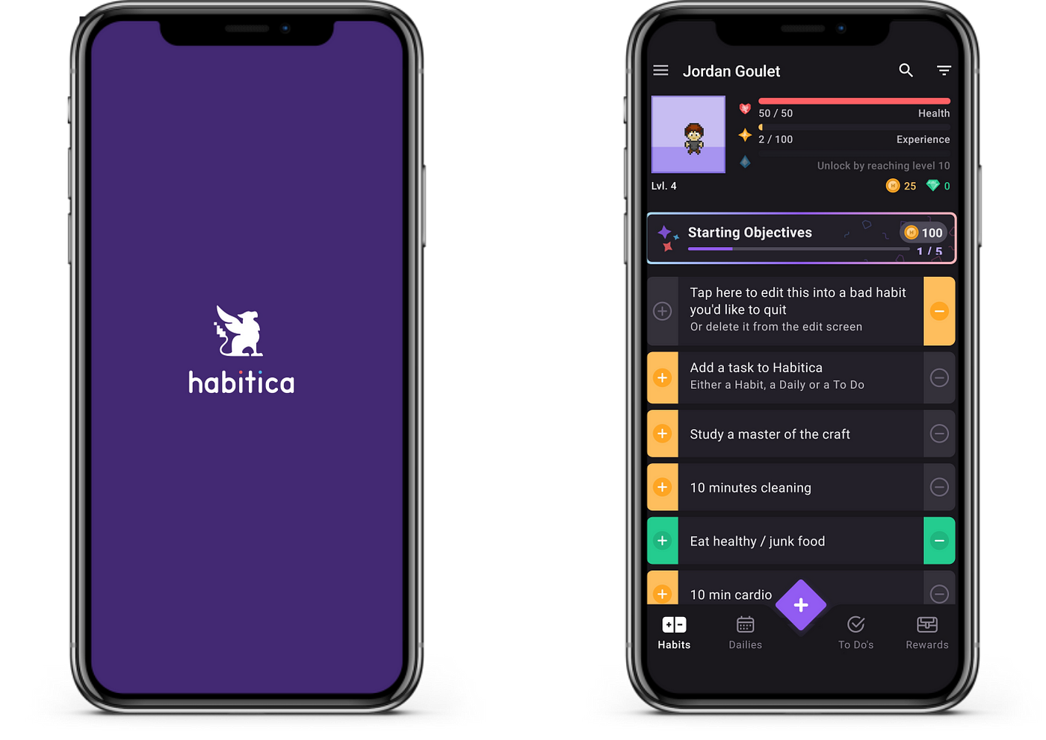
Habitica Application
The Habitica Application provides a gamified approach towards task productivity. The application converts tasks and goals into a game where the user “levels up” based on the user’s level of productivity.
Habitica also provides in-game consequences for missing goals or engaging in bad habits, further enhancing the productivity-boosting element of the game. This is what makes Habitica unique; The utilization of behavioral psychology by using positive reinforcement to create habit loops.​
The main features of this application are:
Task Categories : Habits, Dailies, and To-Dos
Gamified Progression : Experience Points and Gold gains when completing a task, which can be put towards buying in-game rewards.
Damage and Penalties : Missing tasks or bad habits results in taking damage and can lead to loss of in-game rewards or items

Slide 45

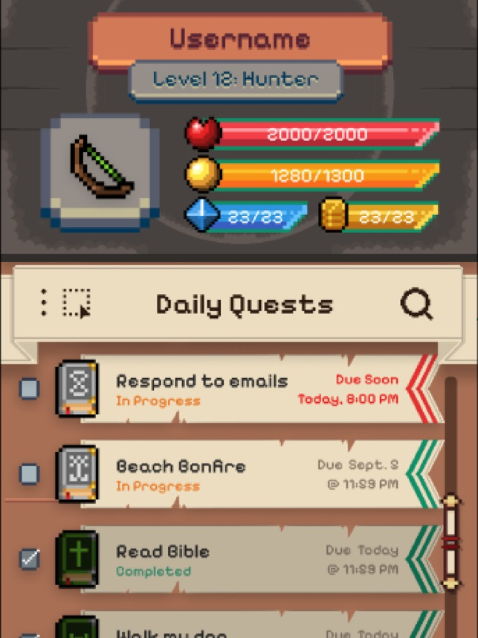
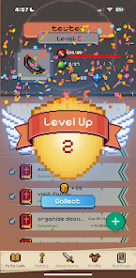
Adventurefy Application
The Adventurefy application takes the gamified approach towards task productivity by converting the user’s to-do list into a series of quests, where completing real-life tasks helps the user progress in the game.
The user’s in-game character has abilities which can be further enhanced by experience points.
The main features of this application are:
Habit Tracking : track current or recurring behaviors that the user may want to build-up or reduce
To-Dos: Manage one-time tasks that contribute to overall progress
Gamified Progression : Earn Experience points that allow the user to enhance their in-game character

Slide 46
Our app implements an AI chatbot to make the user experience more enhanced and more personal. AI feedback is able to send encouragement to motivate, provide focus tips to boost productivity based on previous work sessions, and suggest when the peak productive hours of the user are. The use of AI implemented through Google Gemini API sets us apart from these apps and allows our app to provide users with a unique experience despite the saturation in the productivity app market.
What makes us unique?

Slide 47
Conclusion
Prioritized Core Features
Strategic Differentiation
Structured Planning Approach
Strong Communication & Alignment
Balanced Vision and Feasibility

